Slide 1
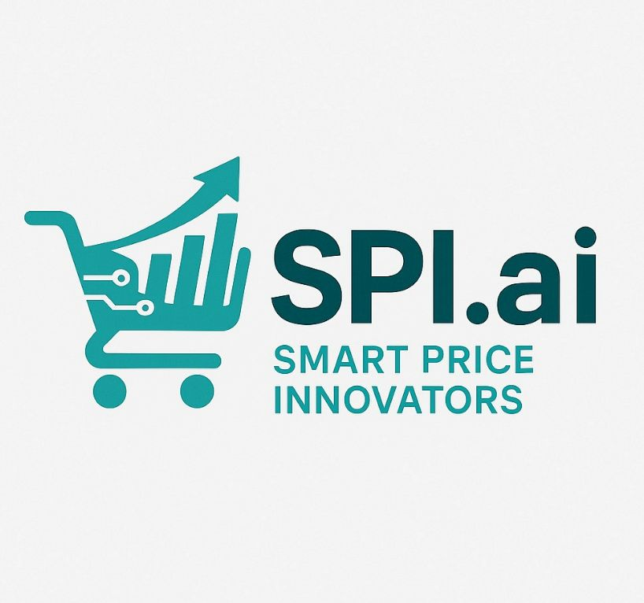
A Platform for Smart Pricing & Market Discovery

Slide 2


TEAM SPI
Affan Ahmed
Aysha Fathima
Sujeevana Jonna
Ashutosh Bhat
Roshan Rath

Slide 3

A SPECIAL THANKS TO OUR MENTOR
MR. SENTHIL MURUGAN
CUSTOMER SOLUTION DIRECTOR
LAVENDAL CONSULTING
3

Slide 4
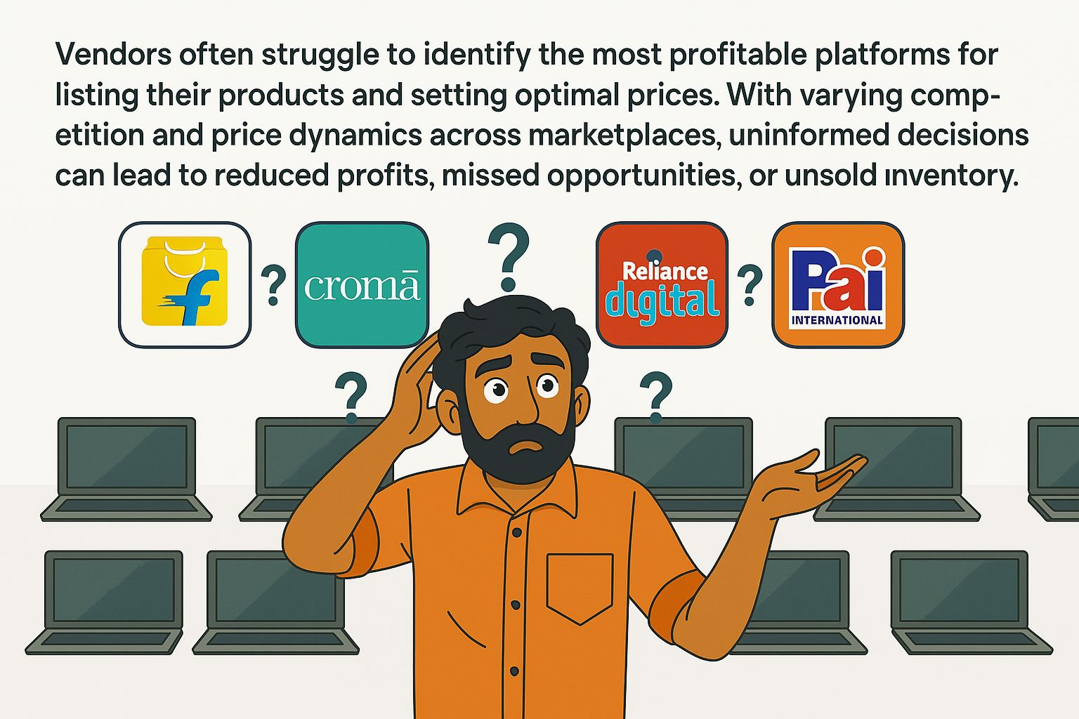
PROBLEM STATEMENT
4

Slide 5


Slide 6
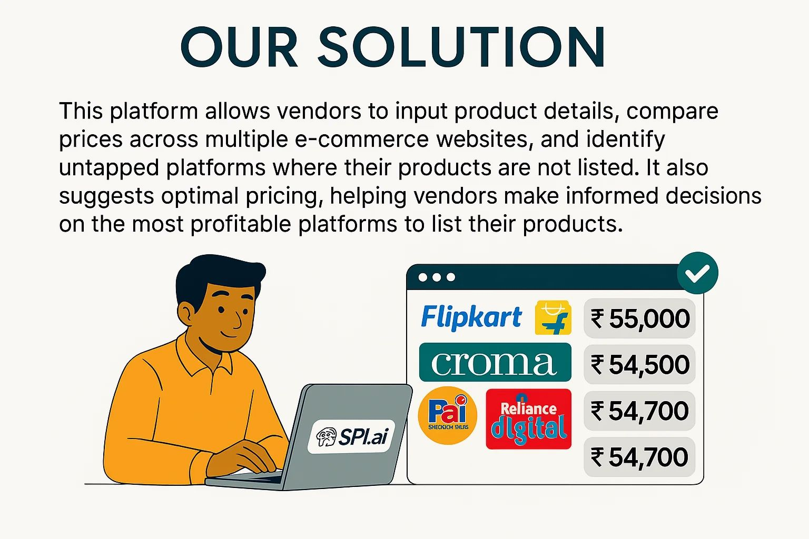


OUR SOLUTION

Slide 7
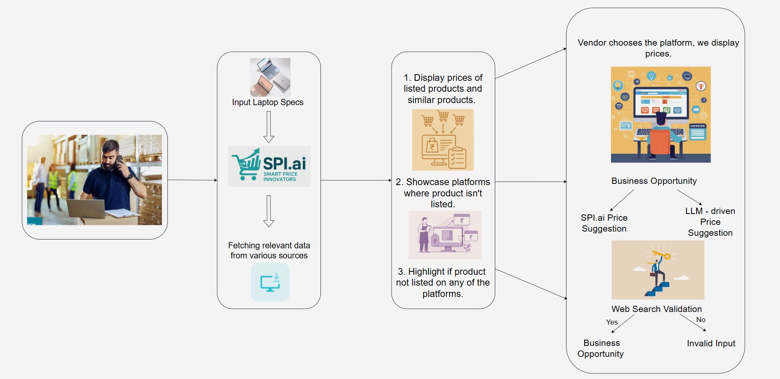
BUSINESS FLOW

Slide 8
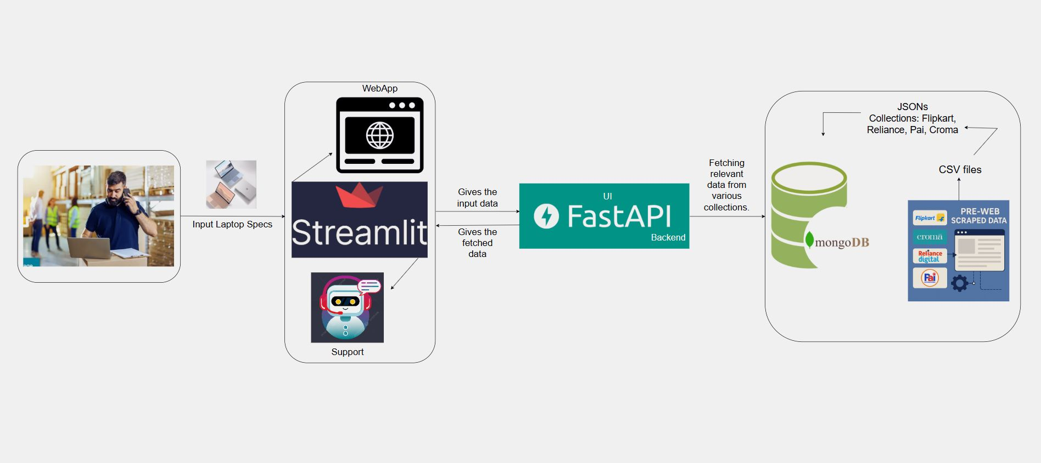
SOLUTION FLOW
8

Slide 9






TECH STACK
Category | Technology/Tool
Frontend | Streamlit
Backend | FastAPI
Database | MongoDB
GenAI | Google Gemini (GenAI)
Web Scraping | Selenium, BeautifulSoup, Chrome Webdriver, EasyScraper, PyAutoGUI
Data Processing | Pandas
Feature Matching | Regular Expressions, Query-based Matching
9

Slide 10
PROJECT HIGHLIGHTS
Smart Product Matching
Vast Market Coverage
Business Opportunity Detection
Smart Price Suggestions
Automation
GenAI-Powered Reasoning
Web Search Validation
User-Friendly Interface
Increased Profitability through Smart Listing

Slide 11
WHERE SPI.AI CREATES IMPACT
Feature | Description
Efficient Price lookup | Helping Vendors Compare Prices Across Platforms — Vendors can easily check laptop prices from multiple e-commerce websites in one place, saving time and effort.
Selection of Platform | Choosing the Best Platform to Sell On — By seeing laptop prices on different websites, vendors can decide where to list their product for maximum visibility and profit.
One stop solution | Saving Time & Effort — Instead of manually checking multiple e-commerce sites, vendors get all price comparisons in one place, making decision-making faster and easier.
Market Analysis | Identifying Market Gaps — The system shows where a particular laptop is missing or underrepresented, helping vendors find better platforms where they can attract more buyers.

Slide 12
SPI.AI EVALUATION SUMMARY
Objective:
To measure how accurately SPI.ai identifies the presence of laptop products across major platforms based on user input.
Definition of Accuracy:
A result is considered accurate if SPI.ai correctly identifies a product on a platform where it actually exists, and triggers price suggestions or validation logic for platforms where it doesn’t.
Conclusion:
SPI.ai delivers high accuracy in platform detection, smart fallback mechanisms for missing data, and reliable invalid combination handling — making it a robust and vendor-friendly tool.
Test Case | Expected Behavior | SPI.ai Behavior | Accuracy Score
Product on all 4 platforms | Retrieve from all 4 platforms | Retrieved from all 4 | 100%
Product on 3 platforms | Retrieve from 3, suggest price for missing 1 | Retrieved + Suggested | 100%
Product on 2 platforms | Retrieve from 2, suggest for other 2 | Retrieved + Suggested | 100%
Product on 1 platform | Retrieve from 1, suggest for remaining 3 | Retrieved + Suggested | 100%
Not in any platform, but exists online | Use web search, validate existence, optionally suggest price | Web search triggered, validation successful | 100%
Not in any platform, doesn't exist | Flag as invalid, no price suggestion | Marked as invalid, no suggestions given | 100%

Slide 13
OVERCOMING CHALLENGES
Problem | Issue Faced | What We Did
Web Scraping | E-commerce sites blocked scrapers and had dynamic layouts | Used undetected Chrome, proxy rotation, multiple headers, and Easy Scraper automated with PyAutoGUI
Database Selection | Different platforms had different schemas and column structures → many nulls | Converted CSVs to cleaned JSON and stored in MongoDB for flexible querying
Manual Evaluation | No benchmark or labeled dataset to validate price suggestions | Manually verified pricing accuracy by cross-checking listings across platforms
Data Preprocessing | Specs like RAM, Storage, Processor were embedded in product names with inconsistent formatting | Applied custom rule-based extraction and cleaned up product titles
Web Search Validation | Needed to check if product combinations existed outside of our database | Generated search-like queries using user filters and validated results via live Google searches

Slide 14
FUTURE SCOPE
Focus Area | Current Gap | What’s Next
Smarter, Real-Time Insights | Data updates are manual and periodic | Automate scraping using scheduled cloud jobs for fresher, always-updated market intelligence
Price Forecasting Through Trends | No use of historical data for price prediction | Store scraped data over time to build trend graphs and enable smart, predictive pricing (time-series models)
Expanding Our Market Reach | Limited to 4 platforms and laptops | Integrate Amazon and expand to new product categories like mobiles and tablets
Vendor-Tailored Pricing Intelligence | One-size-fits-all pricing strategies | Tune pricing strategies based on vendor-specific preferences and dynamic market conditions
Mobile App Integration | No mobile app version available. | Develop and integrate a mobile app for better accessibility and user experience.
14

Slide 15
DEMO

Slide 16


GUIDED BY
DR. SRIDHAR SRINIVASAN
MR. REGI MATHEW
16

Slide 17
THANK YOU

